Slide 1
ANATOMY AND DISEASES OF THE EAR
Presented by: Dr Fahma Aden (ENT Resident)
Department of ENT KIU-Teaching Hospital

Slide 2
OBJECTIVE
To recognize and treat diseases of the ear and their complication and select those for referral

Slide 3
For the purpose of anatomical description the ear divided into three separate portions.
The external ear with:
the auricle or pinna.
the external auditory canal.
The middle ear.
The inner ear

Slide 4
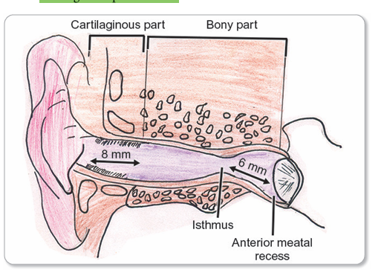
EXTERNAL AUDITORY CANAL ANATOMY

Slide 5
EXTERNAL AUDITORY CANAL (EAC)
The EAC in adults is S-shaped and is 24 mm long. It has 2 parts
1. Cartilaginous part: This is the outer 1/3rd, i.e., 8 mm long (easy to remember the part of EAC adjoining the cartilaginous pinna is cartilaginous).
The skin in this cartilaginous EAC is thick and contains hair follicles, therefore a furuncle is localised only to the cartilaginous part of EAC.
The skin in this cartilaginous EAC also contains ceruminous glands which are the modified sweat (apocrine) glands. So, wax is produced in this portion of EAC.

Slide 6
2. Bony part: This is the inner 2/3rd portion (i.e., 16 mm long) of the EAC. This part is not completely developed at birth.
The narrowest part of EAC called isthmus is situated in this bony portion.
The isthmus is situated 5 mm lateral to the tympanic membrane. Foreign bodies lodged medial to the isthmus, get impacted and are therefore, difficult to remove.

Slide 7
THE MIDDLE EAR:
The tympanic cavity.
The Eustachian tube.
The mastoid air cell system

Slide 8
The tympanic cavity: Contents of the chain of ossicles, the tympanic muscle, and the cord tympanic nerve. The handle of the malleus is attached to the membrane .The incus is suspended between the malleus and stapes.
The tympanic membrane is of clinical importance chiefly on account of the various changes in its appearance in diseased conditions of the middle ear.

Slide 9
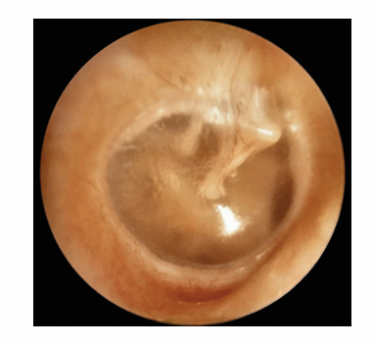
CHARACTERISTICS OF NORMAL TYMPANIC MEMBRANE
The handle of the malleus.
The short process of the malleus.
The triangular cone of light.
The anterior and posterior folds.
The eardrum is pearly gray.

Slide 10
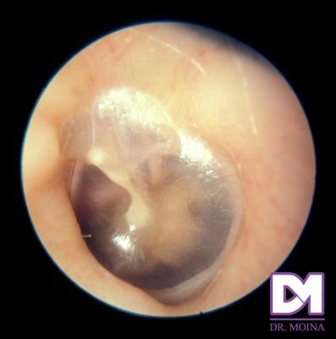

Slide 11
The Eustachian tube
The Eustachian tube connects the middle ear cavity with the nasopharynx. Eustachian tube normally remains closed and opens intermittently during swallowing, yawning and sneezing. Tensor palati muscle plays the major role in opening the tube. Normally the Eustachian tube opens frequently, stably maintaining the middle ear pressure between +50 mm and –50 mm H2O.
The second and most common avenue of approach to the middle ear cavity is trough the Eustachian tube. This not interfere with drainage under normal conditions .If however the cilia are impaired in their functional activity by an inflammatory or other morbil process, the elevated position or the tympanic orifice of the tube materially interferes with the drainage. Anything that obstruction the flow of secretions of the Eustachian tube predisposes the mucous membrane of the tube and middle ear to infection and inflammation.

Slide 12
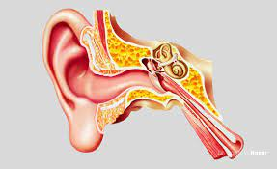
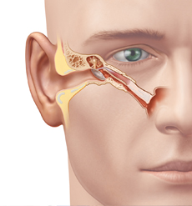

Slide 13
THE INNER EAR.
The front portion is the snail –shaped COCHLEA which functions in HEARING.
The rear part, THE SEMICIRCULAR CANAL .which function is BALANCE.
Interconnecting the cochlea and the semicircular canals is the VESTIBULE, containing the sense organs responsible for balance: The saccule and utricle.

Slide 14
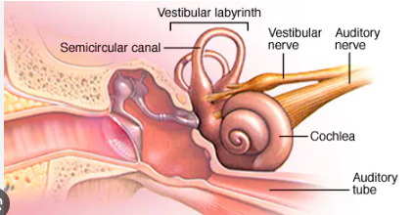

Slide 15
DISEASES OF THE EAR

Slide 16
INTRODUCTION OF OTITIS EXTERNA
Otitis Externa : inflammatory disorders( infectious ) of the external ear includes
-all inflammatory conditions of the auricle
-external ear canal
-and outer surface of the TM
Common childhood disease
Commonly referred to as “swimmer’s ear” or “tropical ear”
Can be acute or chronic

Slide 17
CLASSIFICATION OF OTITIS EXTERNA
On the Basis of Area of Involvement | On the Basis of Aetiology- Infective and Reactive | Based on Onset of Disease
Localized (furunculosis) | Bacterial | Acute (bacterial, fungus, viral)
Diffuse otitis externa Due to Otological causes Dermatological causes | Fungal | Chronic *Contact dermatitis *Psoriasis *Allergic
Malignant Necrotizing Otitis Externa | Viral
 | Reactive *Eczema *Seborhroeic Dermatitis.

Slide 18
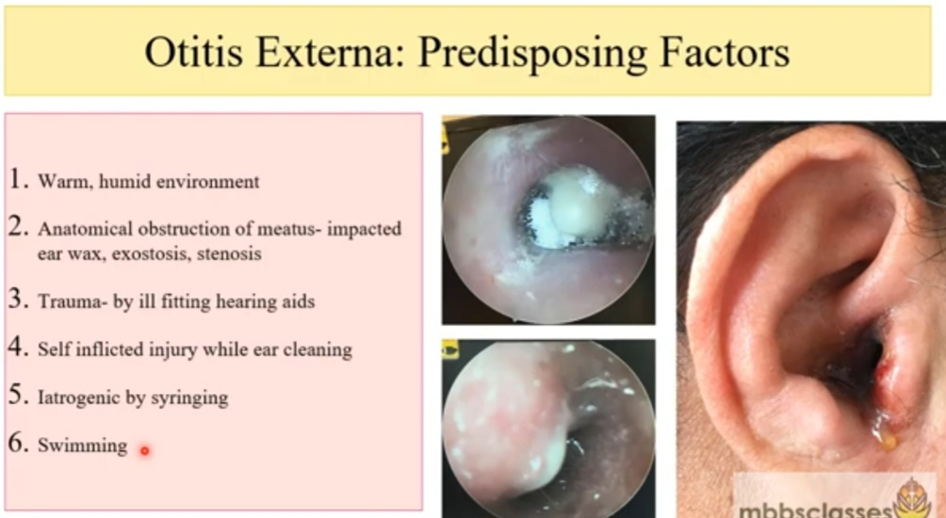

Slide 19
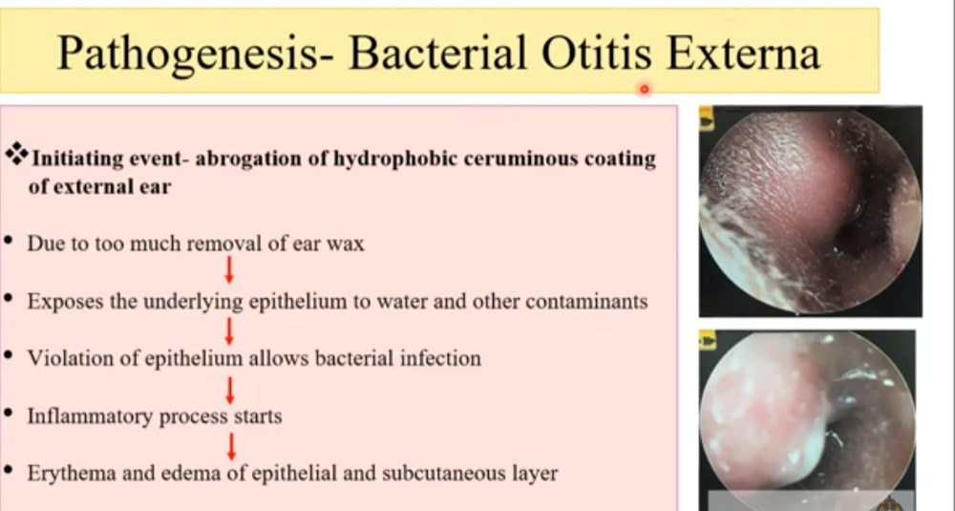

Slide 20
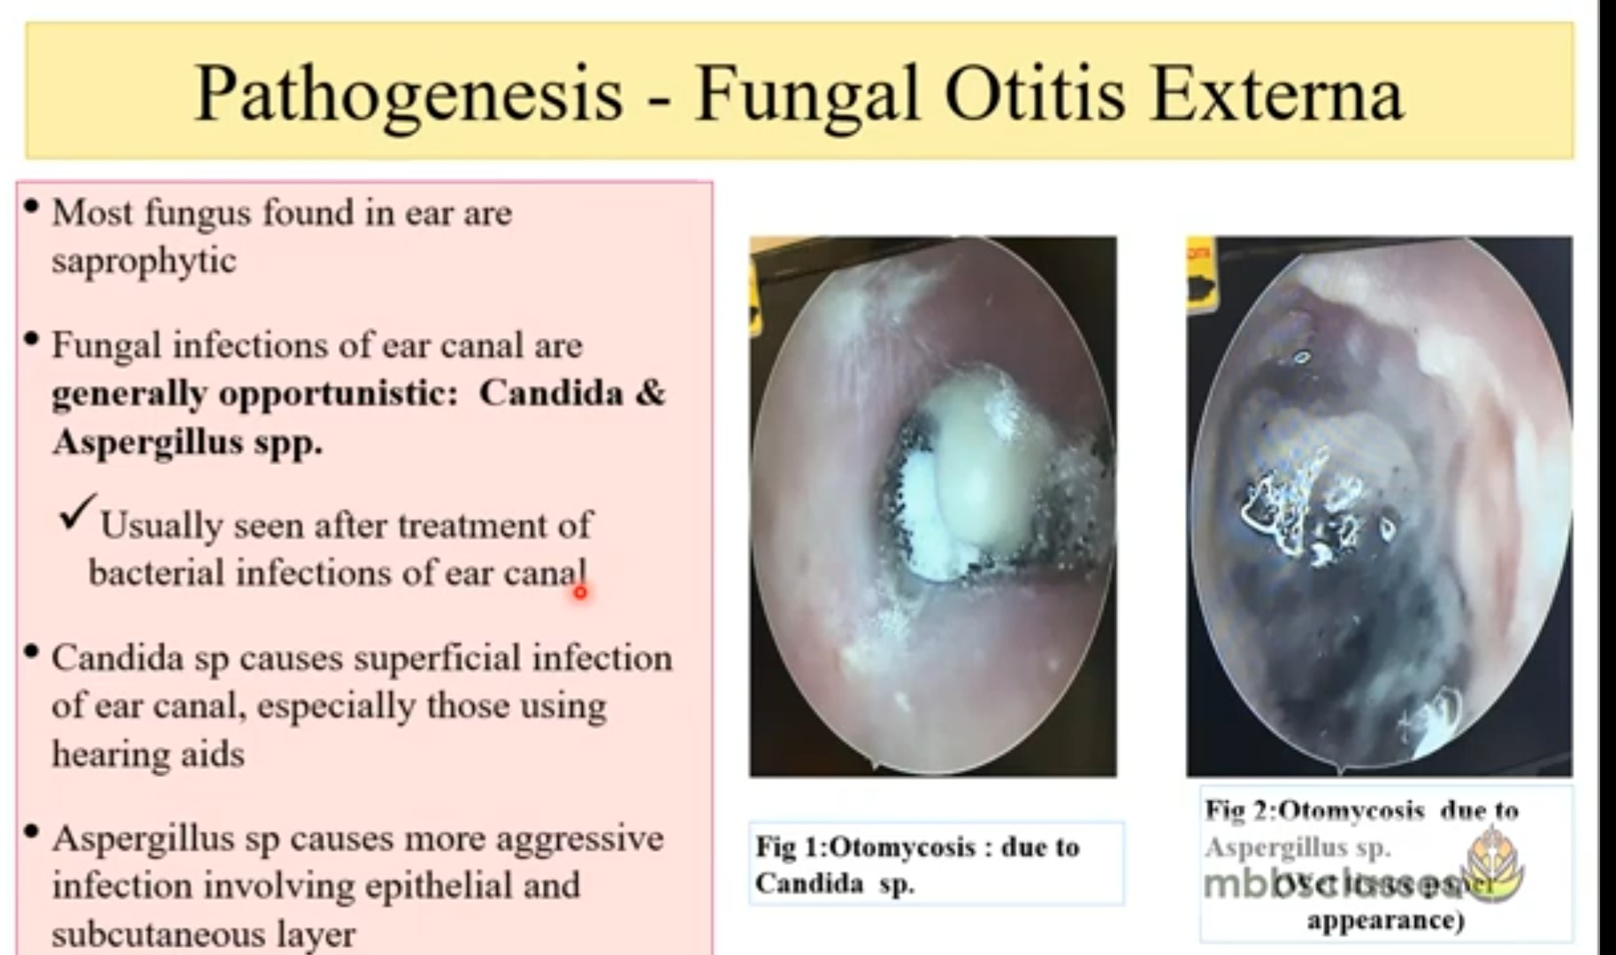
Notes:
Saprophytic -

Slide 21
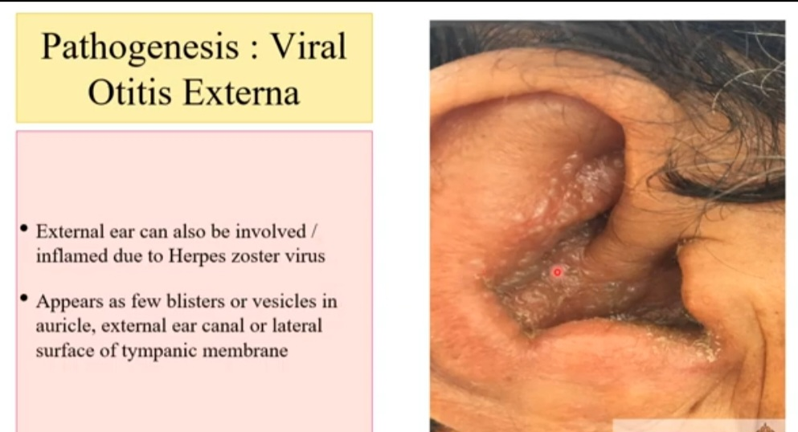

Slide 22
MICROBIOLOGY
Microbiology
53% gram negative: pseudomonas
45% gram positive (Staph Aureus 7.5%, overall stapes sp. 25%)
1.7% yeast/fungus
Viral causes of EAC inflammation:
Herpes virus, varicella-zoster virus

Slide 23
In the patient’s history
1 to 2 days of progressive ear pain
Exposure to water
Itching
Purulent discharge
Conductive hearing loss
Feeling of fullness or pressure

Slide 24
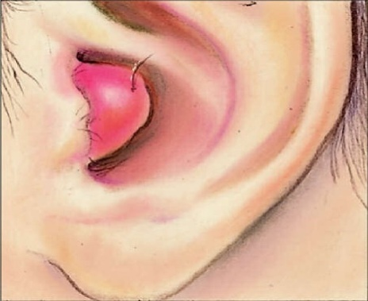
LOCALIZED OTITIS EXTERNA
Staphylococcal infection of a hair follicle is the usual cause of a furuncle. This infection occurs in the lateral cartilaginous hair-bearing portion of the EAC. On otoscopic examination, a furuncle is a localized infection, which may develop into an abscess, rather than the diffuse inflammatory process characteristic of otitis externa.

Slide 25
DIFFUSE OTITIS EXTERNA
Otitis externa is often referred to as "swimmer's ear" because repeated exposure to water can make the ear canal more vulnerable to inflammation.
On physical exam:
Periauricular adenitis
Speculum examination reveals erythema, edema of the epithelium, and accumulation of moist debris in the canal

Slide 26
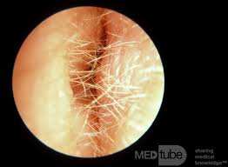
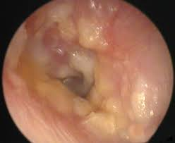

Slide 27
VIRAL OTITIS EXTERNA
Ramsay Hunt syndrome: This condition, more accurately known as herpes zoster oticus, is caused by varicella-zoster viral infection. Ramsay Hunt syndrome is characterized by facial nerve paralysis and sensorineural hearing loss, with bullous myringitis and a vesicular eruption of the concha of the pinna and the EAC.

Slide 28
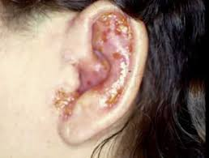
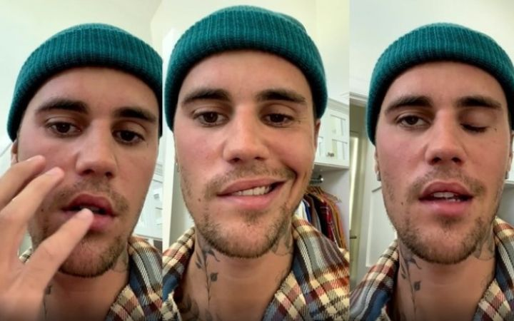

Slide 29
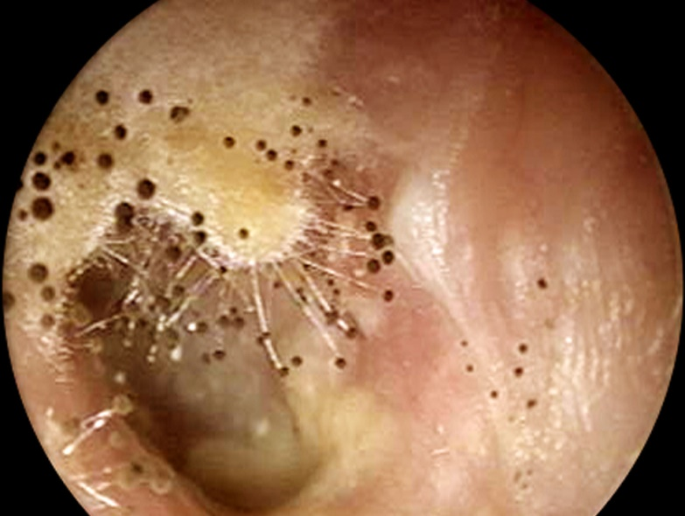
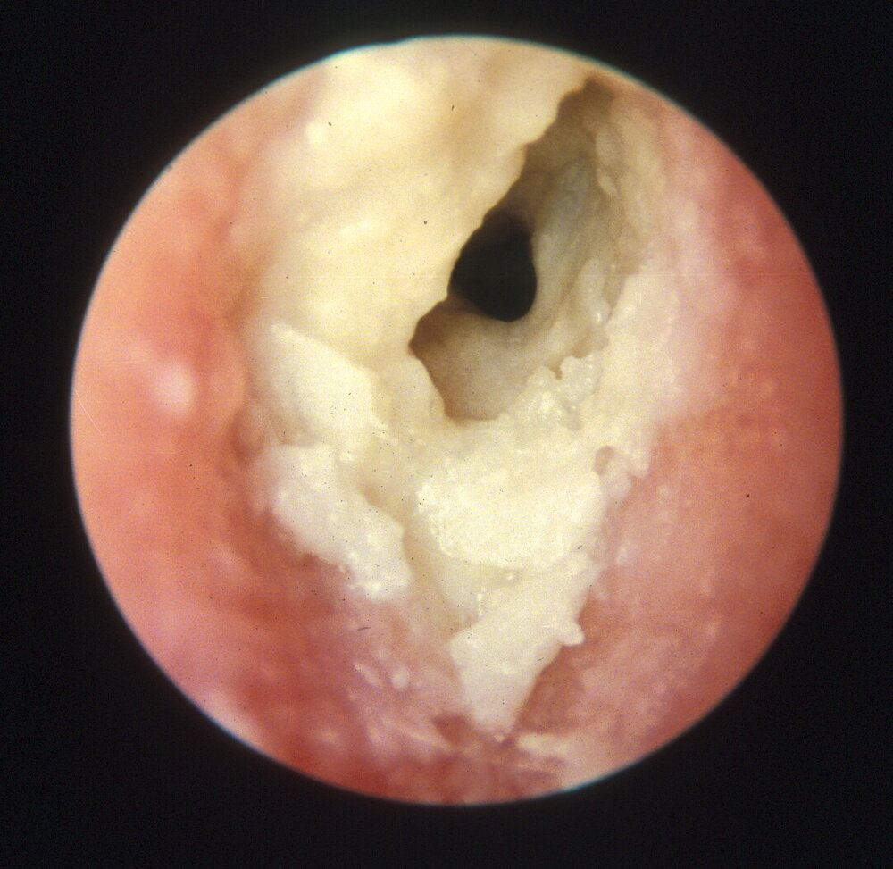
Fungal otitis externa or otomycosis
Spores and hyphae may be seen in the external canal

Slide 30
LABS/WORKUP
Usually after failed empiric therapy:
bacterial and fungal culture
Adults with otitis externa: screening blood glucose and/or a urine dipstick test to rule out occult diabetes

Slide 31
IMAGING
Imaging studies are not required for simple otitis externa
However, in patients with suspected malignant otitis externa (diabetic or immunocompromised):
scan using CT with contrast
Additional/Optional:
MRI of the temporal bone
triple-phase bone scanning using Technetium-99m
gallium scanning

Slide 32
TREATMENT
Goals:
1. Antimicrobial therapy that eradicates the 2 most common bacterial causes: Pseudomonas and Staph aureus
2. Aural toilet- remove as much debris as possible
3. Pain control
4. Dry Ear precautions
5. Patient instructions in proper use of ear drops
6. Ear wick?

Slide 33
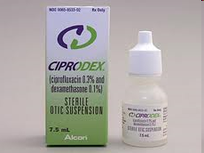
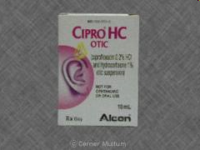
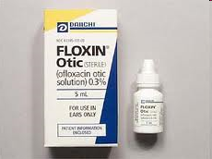
TREATMENT
Topical Antibiotic Treatment Options
Aminoglycosides
- neomycin is often combined with a second antibiotic (polymixin) and a steroid
- polymixin covers pseudomonas. Polymixin/neomycin have 87-97% cure rates
- gentamicin also sometimes used
Quinolones
Now Considered First-line Therapy

Slide 34
GENERAL TREATMENT
Analgesics
Anti-inflammatories
Antihistamines

Slide 35
COMPLICATIONS/SEQUELAE
Stenosis of the ear canal
Cellulitis/chondritis
Parotiditis
Necrotizing OE
Patient who are susceptible have immune dysfunction ( leukemia, drug-induce leukopenia, immunoglobulin deficiency, and DM)

Slide 36
CHRONIC OTITIS EXTERNA- ETIOLOGIES
Allergic: reactions to topical agents, manifest as maculopapular eruptions on the skin of the conceal and ear canal.
Contact dermatitis: reaction to hairspray, shampoo, hair dye, hearing aid moulds.
Psoriasis: such as seborrhea can involve ear canal-results in hyperkeratosis and lichenification of the ear canal skin.

Slide 37
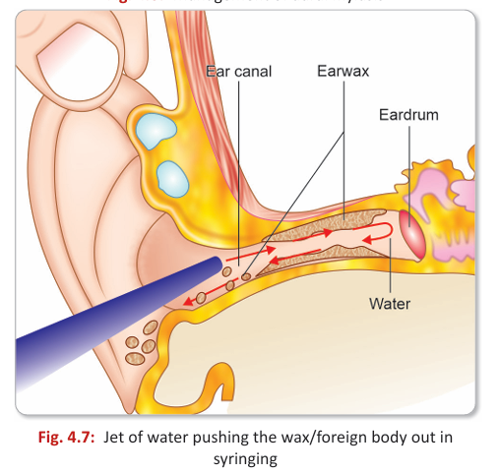
WAX
Wax is usually a mixture of secretions of ceruminous and sebaceous glands. The ceruminous glands are modified sweat (apocrine) glands, located in the cartilaginous part of EAC and produce cerumen, the main constituent of wax.
CLINICAL FEATURES
The patient can present with blocked ear, hearing loss, earache, itching in the ear and tinnitus.
MANAGEMENT
Wax softening agents are administered and then the wax removal is done under direct vision by headlight, microscope or endoscope with Jobson-Horne probe or by syringing.

Slide 38
ACUTE OTITIS MEDIA (AOM)
Inflammation of mucous membrane of the meddle ear cavity is a common condition and is frequently bilateral. It occurs most commonly in children. There is nearly always a proceeding upper respiratory infection.
AETIOLOGY
Acute otitis media is caused due to viral, bacterial or coexisting causes
The bacteria most commonly involved are H. influenza, Streptococcus pneumonia, and Streptococcus aureus.
The most common viral pathogens include the respiratory syncytial virus (RSV), corona viruses, influenza viruses, and adenoviruses.

Slide 39
ROUTES OF INFECTION
1. The most common route of spread of infection is via the Eustachian tube. This is especially common in children, due to the Eustachian tube being more horizontal, shorter and patulous. This risk increases with careless bottle feeding or use of pacifiers.
2. The infection may directly travel to the middle ear via the tympanic membrane perforation.
3. Haematogenous route is also a possible route for spread of infection to the middle ear.

Slide 40
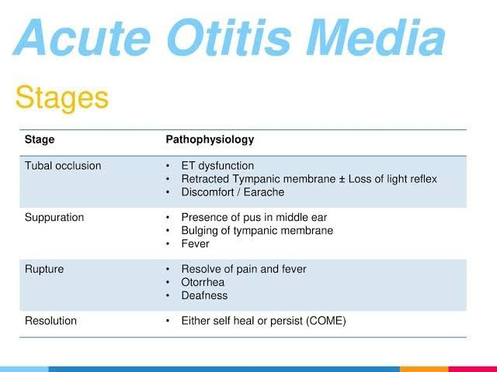
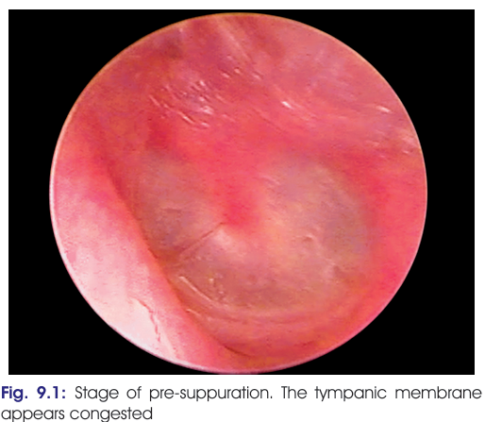

Slide 41
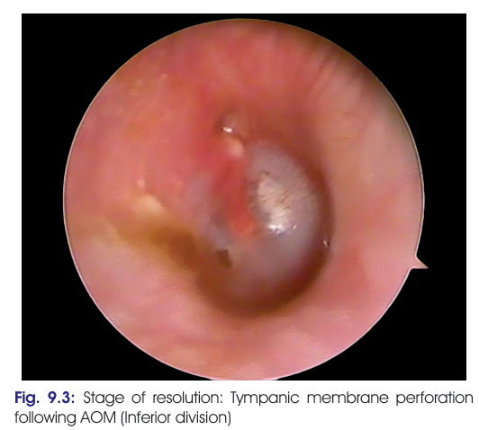
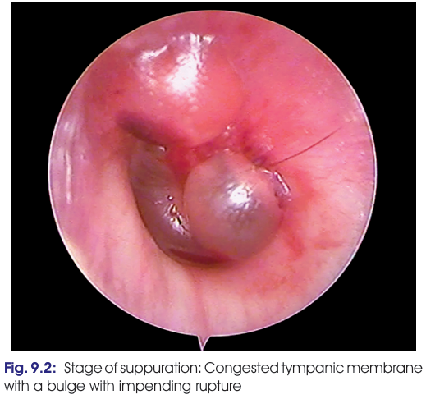

Slide 42
TREATMENT
Local:
Inhalation of water vapor 3 times a day.
Nose drops: Betadrops, Ephedrine.
General:
Antibiotics
Analgesics
Anti-inflammatories
Antihistamine

Slide 43
CHRONIC OTITIS MEDIA
The chronic otitis media (COM) is defined as inflammation of the middle ear cleft which results in permanent abnormality of the tympanic membrane involving pars tensa or flaccida.
AETIOLOGY
1.Environmental: There is a close correlation between low socioeconomic status and overcrowding with the COM.
2. Genetic: The mastoid air cell system has been seen to be sclerosed in COM patients. This happens because of the disease process or it is the primary factor for disease formation is not established.
3. Recurrent attacks of AOM: It leads to thinning of the fibrous layer or a permanent defect in the tympanic membrane.
4. Infections: This has been established that bacteria in ears with COM are secondary invaders of the mucosa which has been inflamed by other factors like allergy, rather than the primary cause for disease.
5. Upper respiratory tract infections: These have a viral aetiology to start with, but later develop superadded bacterial infection which reach the middle ear cleft via Eustachian tube.
6. Allergy
7. Nasal obstruction from adenoids
8. Autoimmune disorders: Rheumatoid arthritis has shown a correlation with COM

Slide 44
CLINICAL FEATURES
1. Ear discharge: The discharge is the most common presentation of mucosal COM.
2. Hearing loss: Majority of patients will complain of hearing loss. It is usually conductive in nature.
3. Polyps: The mucosal oedema may lead to the formation of aural polyps, which may protrude from the perforation into the external auditory canal.
4. Ossicular chain necrosis: The ossicles are usually not involved in mucosal type of COM but may get necrosed in a few cases.

Slide 45
INVESTIGATIONS
Culture and sensitivity is recommended in non-drying ears or in patients with infective complications of COM.
Examination under microscope (EUM) or otoendo scopy are done in all cases to confirm the otoscopic findings.
Pure tone audiometry (PTA) is done to assess the degree and type of hearing loss.

Slide 46
MANAGEMENT
Cleaning of the ear properly and proper instillation of eardrops are the mainstay in medical management of chronic otitis media.
Aural toileting: removing the debris and discharge in the affected ear.
Ear drops: The antibiotic ear drops used commonly are ciprofloxacin, chloramphenicol and polymyxin.
Systemic antibiotics: They are reserved for acute infections in COM and patients with associated URI or complications.
Acetic acid irrigation (1%) may be done in non-drying ears. It has antipseudomonal activity.

Slide 47
COMPLICATIONS OF OTITIS MEDIA
Extra cranial.
Acute mastoiditis.
Laberintitis.
Otic septicemia
Facial paralysis.
Intracranial.
Per sinus abscess.
Sigmoid lateral sinus thrombosis.
Cavernous thrombosis. Extradural abscess.
Otogenic brain abscess.
Meningitis .
Cerebelar abscess

Slide 48
FORIENG BODY OF EAR
Foreign bodies in the EAC are seen most commonly in children and may be organic (e.g., beans, live insects, etc.) or inorganic (e.g., cotton, paper, beads, button batteries, etc.).
Clinical Features
Asymptomatic
Pain
Otitis externa

Slide 49
MANAGEMENT
The method of removal of FB depends on the nature of the foreign body.
Inorganic round non graspable FB (e.g., beads, pellets, erasers) should be removed by syringing.
Graspable non-living objects (e.g., cotton, paper, dead insects) should be removed with a pair of crocodile forceps.
Living insects should be first killed by putting oil into the meatus and then removal by syringing or forceps.
Organic objects (e.g., beans) which absorb water and swell, should not be syringed. They should be removed with ear hook.
Button batteries should not be syringed as they may leak on exposure of water.
Firmly impacted FB medial to isthmus of EAC are removed surgically or by instrumentation.
Syringing: After pulling the pinna upward and backward, water at body temperature is delivered through a syringe along the posterosuperior wall of EAC. The pressure of water builds up in the meatal recess and pushes the wax out.

Slide 50
COMPLICATIONS OF SYRINGING:
Vertigo (if water is too hot or too cold, i.e., not at body temperature, due to caloric stimulation)
Rupture of TM (if done too forcefully)
Reactivation of quiescent otitis media (if perforation is already present)
CONTRAINDICATIONS OF SYRINGING:
Acute inflammatory conditions of the external or middle ear.
Perforation of the tympanic membrane
Presence of a grommet
History of ear surgery
Foreign body battery in the EAC

Slide 51
HEARING LOSS
Hearing loss affects people of all ages and can be caused by many different factors. The three basic categories of hearing loss are sensorineural hearing loss, conductive hearing loss and mixed hearing loss.

Slide 52
SENSORINEURAL HEARING LOSS
This type of hearing loss occurs when the inner ear or the actual hearing nerve itself becomes damaged.
It can be a result of aging, exposure to loud noise, injury, disease, certain drugs or an inherited condition.

Slide 53
CONDUCTIVE HEARING LOSS
This type of hearing loss occurs in the external or middle ear where sound waves are not able to carry all the way through to the inner ear.
Sound may be blocked by earwax or a foreign object located in the ear canal; the middle ear space may be impacted with fluid, infection or a bone abnormality; or the eardrum may have been injured.

Slide 54
The Weber test compares hearing, by bone conduction, of two ears, simultaneously, and assesses the sensation of lateralization of the sound to one side or the other.
The Rinne test compares hearing by air and by bone conduction, in each ear, separately.
The Schwabach test consists in comparing the time of audition of a vibrating tuning fork, placed at the vertex of the patient, with the time over which he hears, this same tuning fork, a subject with normal hearing, usually the own explorer.

Slide 55
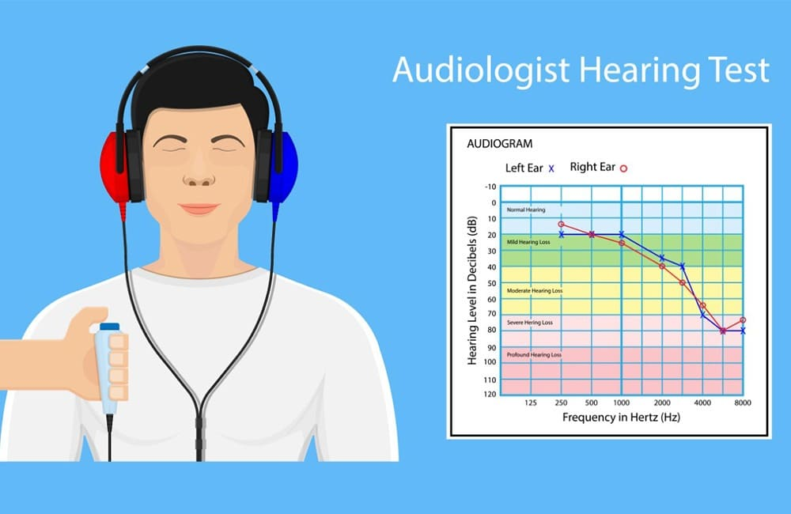
AUDIOMETRY
An audiometry exam tests your ability to hear sounds. Sounds vary, based on their loudness (intensity) and the speed of sound wave vibrations (tone).
Hearing occurs when sound waves stimulate the nerves of the inner ear. The sound then travels along nerve pathways to the brain.
Sound waves can travel to the inner ear through the ear canal, eardrum, and bones of the middle ear (air conduction). They can also pass through the bones around and behind the ear (bone conduction).

Slide 56
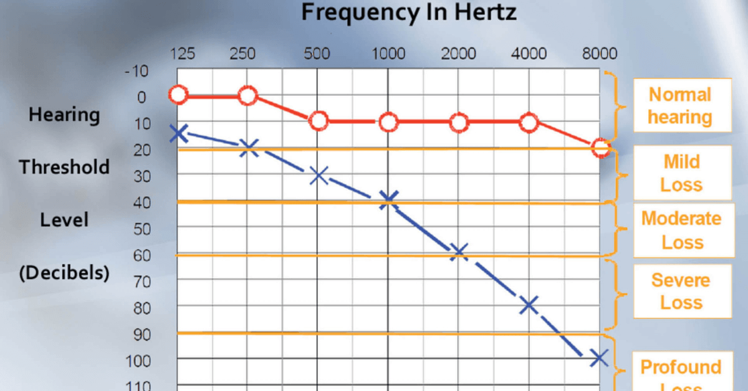

Slide 57
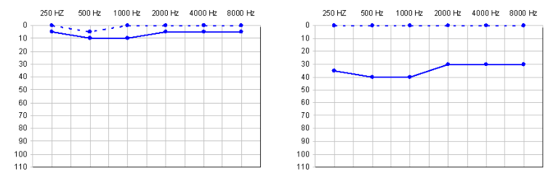
Bone conduction
Bone conduction
Continuous lines
Discontinue lines
Air conduction
Conductive hearing loss
Normal Hearing

Slide 58
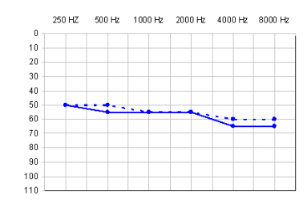
Sensorineural Hearing loss

Slide 59
Aspects | Sensorineural Hearing loss | Conductive Hearing loss
Rinne’s Test | Shortened positive | Negative
Weber’s Test | Lateralized to the healthy side or better | Lateralized towards the diseased or more injured side
Schwabach's Test | Shortened | Elongated
Audiometry | Sensorineural hearing loss | Conductive hearing loss
Tympanometry | Normal | Altered
Stapedial/ Acousticreflexes | Absent | Present

Slide 60
Thanks

